Slide 1
INFRA-SCOPE:SMART DAMAGE DETECTION FOR SAFER INFRASTRUCTURE
Team Details:
Name: Al Shifa R /211423104030 Name: Anitha C /211423104043 Batch Number: A29
Domain: Artificial Intelligence and Machine Learning
Coordinator Name & Designation
Dr. Kavitha Subramaniam Professor
Guide Name & Designation: Ms. S. Rohini, M.E. – Assistant Professor
Date:29.10.2025

Slide 2


SDGs and TARGETs
SDG 9 – Industry, Innovation and Infrastructure
Promotes development of reliable, sustainable, and resilient infrastructure supporting economic growth and human well-being.
INFRA-SCOPE contributes through drone-based monitoring and AI-driven safety analysis for existing infrastructures.
Supports Targets 9.1 and 9.4 by encouraging modernization and innovation in inspection technologies.
SDG 11 – Sustainable Cities and Communities
Aims to make cities and communities safe, resilient, and sustainable through improved infrastructure management.
INFRA-SCOPE helps identify early damages in urban structures to prevent accidents and extend their life cycle.
Aligns with Targets 11.3 and 11.5 by promoting proactive urban maintenance and safety planning
SDG 13 – Climate Action
Focuses on strengthening resilience and adaptive capacity to climate-related impacts and disasters.
INFRA-SCOPE supports early detection of climate-induced damages such as corrosion or cracks caused by environmental factors.
Contributes to Targets 13.1 and 13.3 by improving awareness and preparedness through data-driven monitoring systems.

Slide 3
INTRODUCTION
Infrastructure health monitoring is vital for maintaining safety, longevity, and operational reliability of public structures.
Manual inspection methods are labor-intensive, time-consuming, and prone to human errors.
Advances in drone technology have enabled remote monitoring of hard-to-reach areas with high precision.
Artificial Intelligence enhances image interpretation, automatically classifying structural defects.
Cloud integration supports real-time data transfer, enabling proactive maintenance decisions and timely interventions.

Slide 4
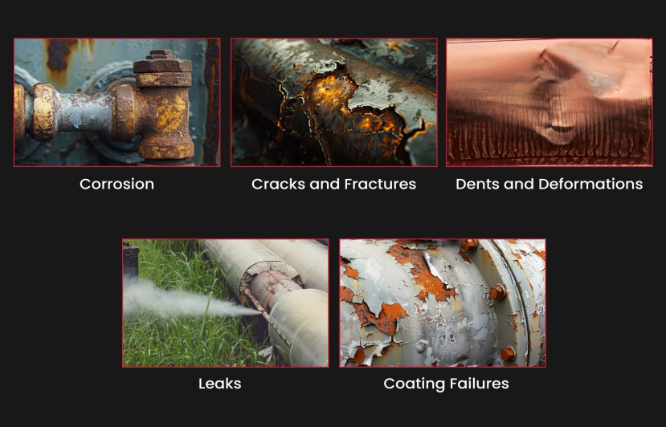
Problem Statement
Manual Inspection Challenges:
Current infrastructure inspections are largely manual, making them dangerous, time-consuming, and prone to human error.
Limited Accessibility:
Human inspections face difficulties in reaching elevated, remote, or complex structural areas.
Lack of Automation:
There is no automated system for real-time damage detection or predictive maintenance.
Poor Digital Integration:
Absence of a unified digital monitoring platform leads to delays in identifying and reporting faults.
Need for Smart Framework:
Hence, there is a strong need for a drone-based intelligent system that ensures safety, operational speed, and data-driven accuracy.

Slide 5
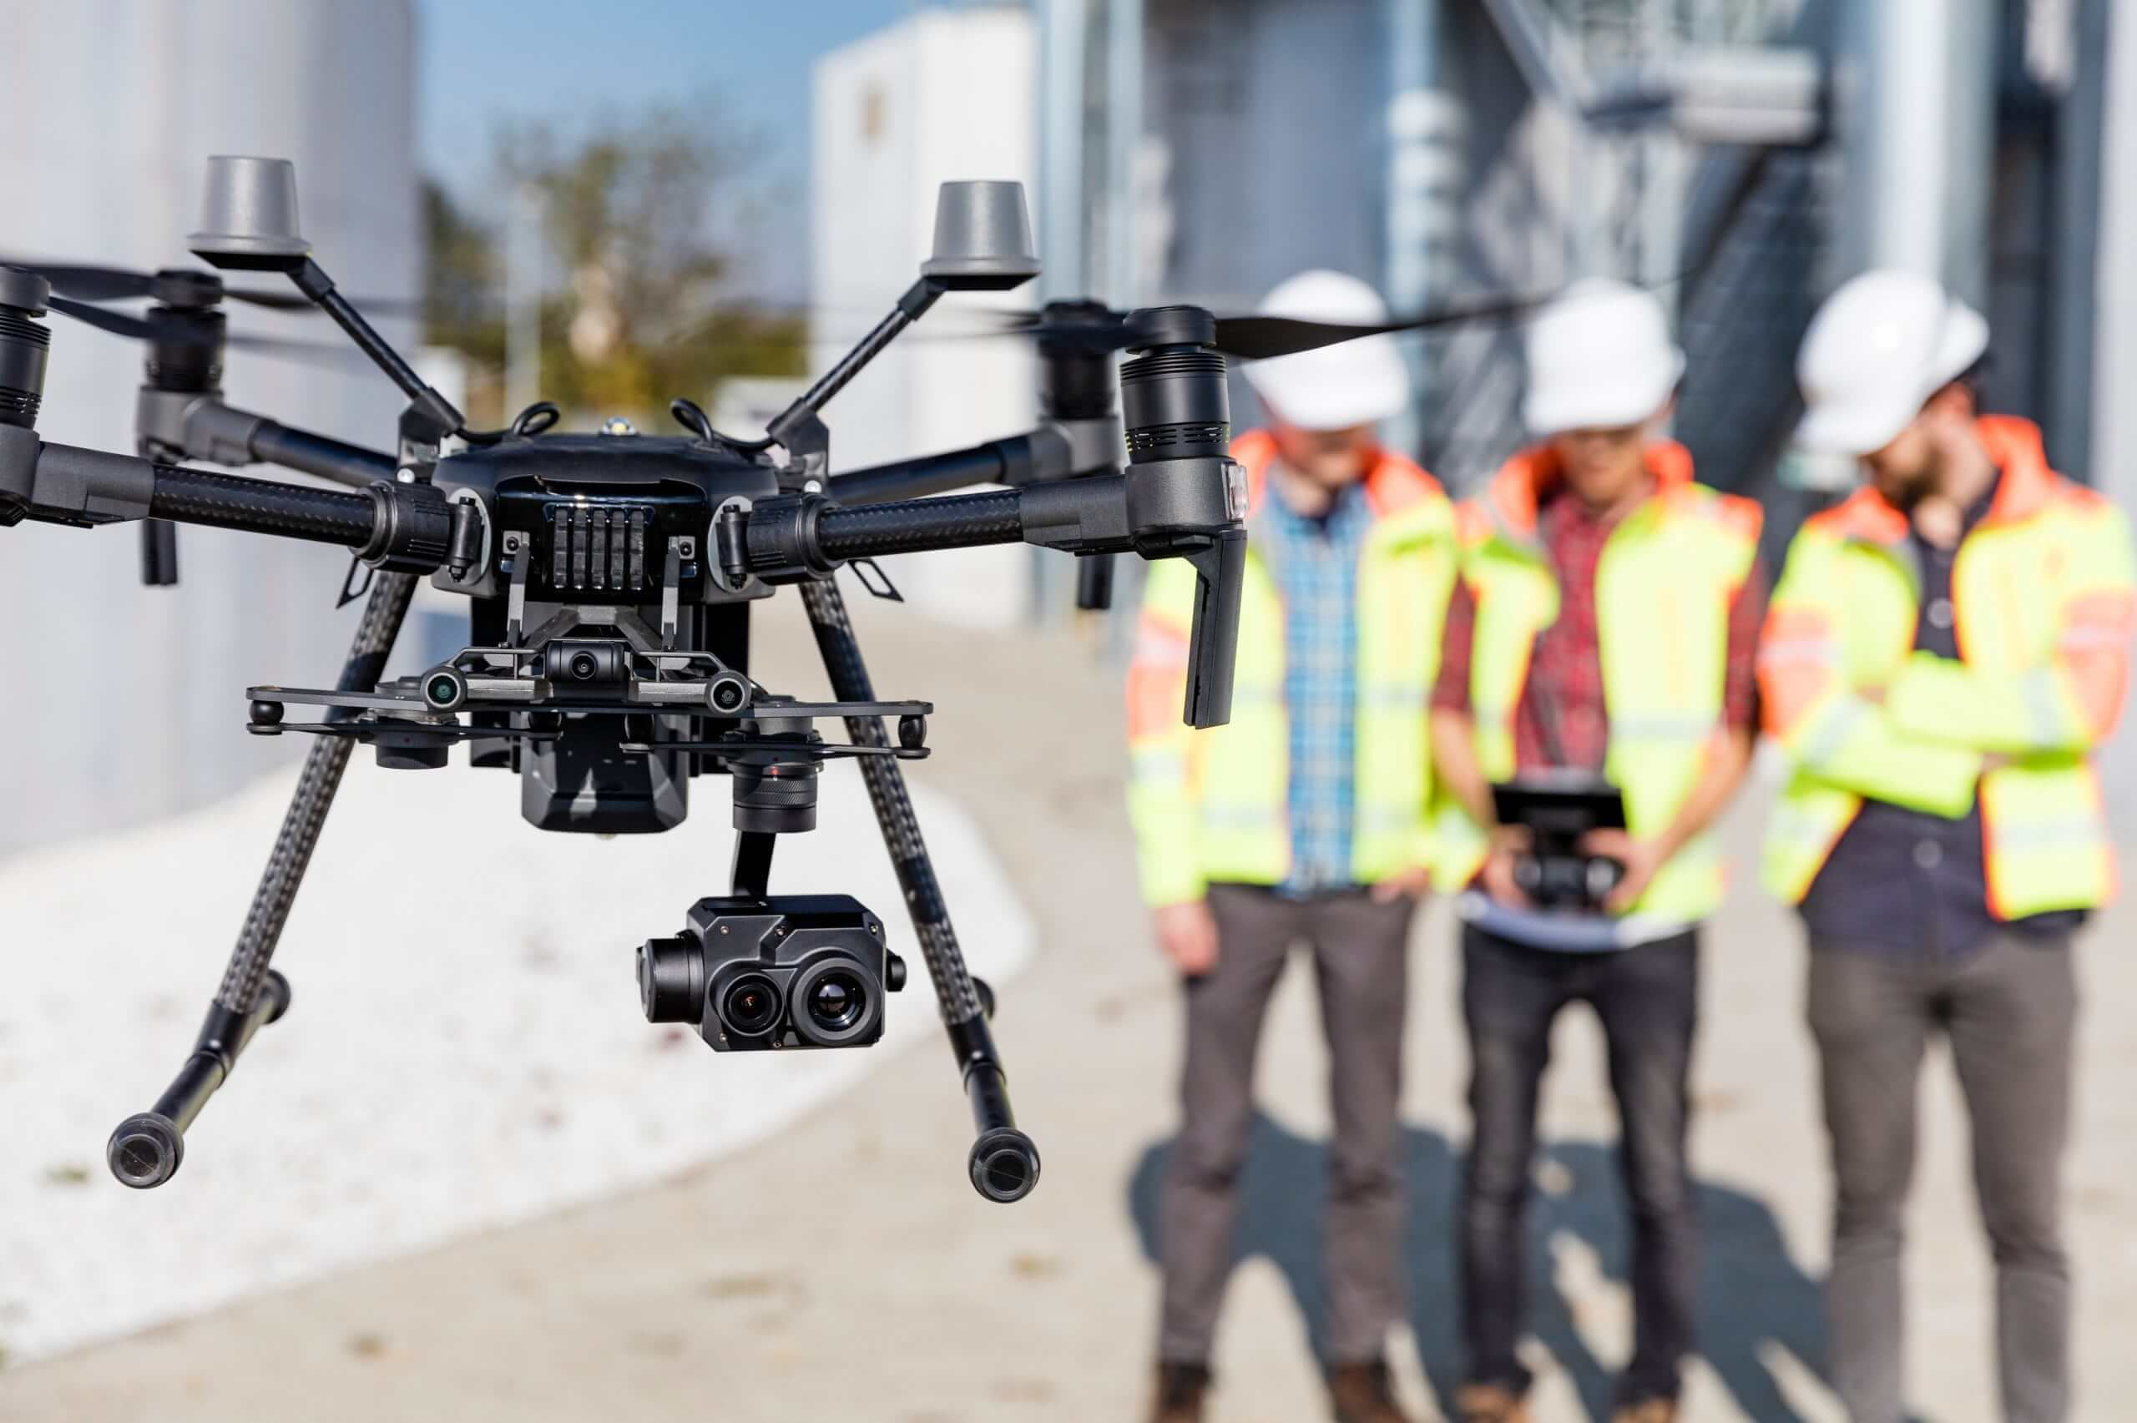
Abstract
INFRA-SCOPE is an AI- and drone-powered inspection framework for detecting damages in infrastructures like bridges, towers, and pipelines.
It integrates AI, IoT, and Cloud computing to collect, analyze, and visualize structural data in real time.
Drones capture high-resolution images and sensor readings, which are processed using machine learning to identify cracks, corrosion, or deformations.
The system ensures faster inspections, improved safety, and lower maintenance costs by eliminating human intervention in risky zones.
Results are displayed on a centralized dashboard with instant alerts for critical damages.

Slide 6
OBJECTIVES
Design a smart inspection system that automates damage detection using drones and AI.
Achieve real-time monitoring with cloud-based dashboards and alert mechanisms.
Reduce human dependency and risk exposure during inspection of tall or hazardous structures.
Improve accuracy and reliability of defect detection compared to traditional manual methods.
Provide an efficient, scalable solution that supports sustainable infrastructure management and predictive maintenance.

Slide 7
Research and Literature Review
Author / Year | Method / System | Key Findings | Limitations
O. B. Schofield et al., 2023 | UAV power-line detection and tracking | Improved accuracy in automatic power line following | Requires enhanced stability and real-time control
J. Zhang et al., 2022 | Internet of Drones Framework | Enabled open-source cloud-based management | High network bandwidth needed
Mehrooz et al., 2019 | Connected drone inspection platform | AI-driven defect identification and reporting | Relies heavily on cloud availability
eSmart Systems, 2021 | Commercial drone use in utilities | Reduced human risk and cost by 40% | Regulatory constraints in operation
PwC Report, 2017 | Autonomous drone control platform | Offers end-to-end inspection workflow automation | High setup and maintenance cost

Slide 8
Research and Literature Review
Delair, 2019 | Industrial drone inspection solutions | Provides high-resolution aerial data for defect analysis | Minimal onboard AI capabilities
EASA, 2019 | EU regulatory standards for drones | Ensures operational safety and compliance | Does not cover AI integration aspects
Scopito, 2019 | Drone data management software | Enables comparative analysis over time | Lacks automation in labeling
G. Mehrooz et al., 2020 | IoT-integrated UAV communication system | Improved autonomous decision-making | Latency during data upload

Slide 9
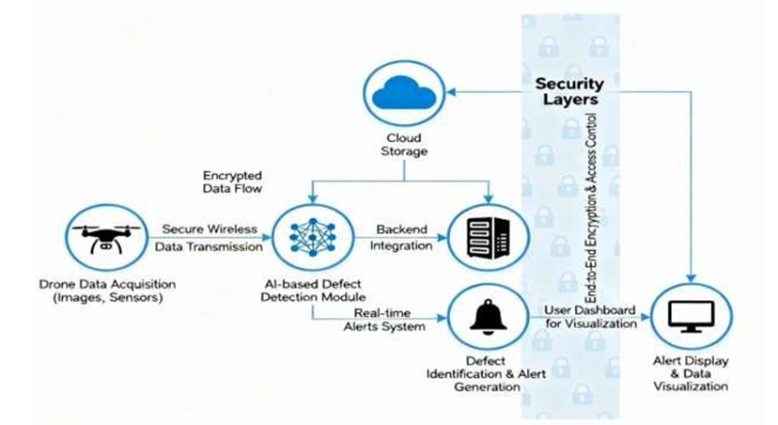
ARCHITECTURE DIAGRAM

Slide 10
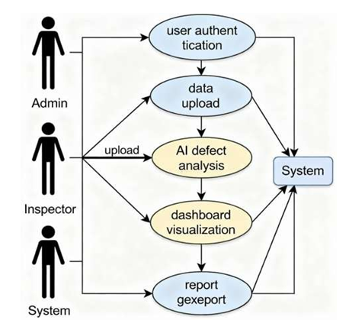
UML DIAGRAMS-USE CASE DIAGRAM

Slide 11
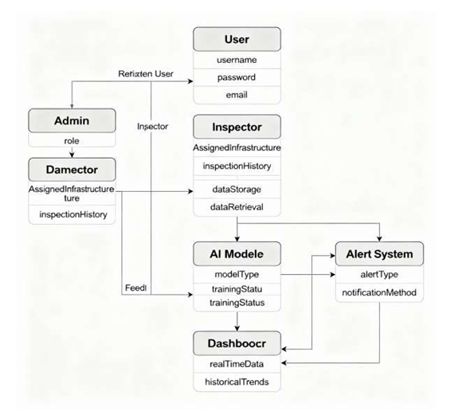
CLASS DIAGRAM

Slide 12
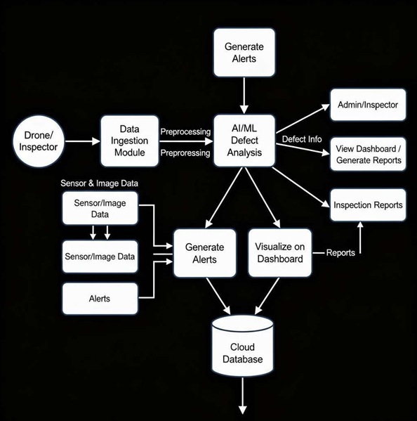
DATAFLOW DIAGRAM

Slide 13
Module Description
Drone Data Acquisition Module: This module is responsible for capturing high-resolution aerial images, thermal and LiDAR sensor data, and precise GPS coordinates. It serves as the primary input source for the entire inspection process, ensuring accurate and comprehensive data collection.
Pre-Processing Module: The captured data undergoes preprocessing to remove noise, adjust image contrast, and normalize inputs. This step enhances image clarity and prepares consistent datasets for the AI analysis stage.
AI Analysis Module: Utilizing advanced algorithms such as Convolutional Neural Networks (CNN) and Random Forest, this module automatically identifies and classifies structural defects including cracks, corrosion, and surface anomalies.
Alert Generation Module: When abnormalities are detected, this module immediately sends real-time alerts and notifications to maintenance teams via the integrated web or mobile application, enabling prompt action.
Dashboard Visualization: A dynamic dashboard provides real-time visualization of inspection results, damage locations, and performance trends. It also allows comparison with historical data for trend-based maintenance decisions.
Database and Security Layer: This module ensures secure storage and management of inspection data using encryption and authentication mechanisms, maintaining data integrity and privacy throughout the workflow.

Slide 14
Algorithm / Methodology
Mission Planning: The inspection process begins with defining the drone’s flight path, altitude, and coverage area. Waypoints are configured to ensure complete and efficient data collection over the target infrastructure.
Autonomous Flight Operation: Drones operate autonomously along the planned route, capturing high-resolution images and multispectral sensor data from various angles to ensure full surface coverage.
Data Transmission to Cloud: The collected data is securely transmitted to a cloud-based server using protocols such as MQTT or HTTPS. This enables real-time access, storage, and synchronization for subsequent analysis.
AI-Based Defect Detection: The uploaded data is processed using AI algorithms such as Convolutional Neural Networks (CNN) for pixel-wise defect segmentation. Defect Area = Σ[I(i) > Tcrack] is applied to identify regions exceeding threshold intensity, indicating cracks or surface damage.
Result Generation and Reporting: The analyzed outputs are compiled into visual inspection reports that highlight defect locations, severity levels, and recommended maintenance actions.
Continuous Learning and Optimization: The AI model is periodically retrained using expert-verified inspection data, allowing continuous improvement in accuracy and adaptability for diverse infrastructure types.

Slide 15
TESTING
Functional Testing: Each core module — including drone control, data acquisition, AI detection, and dashboard — was individually tested to verify correct operation and internal consistency.
Integration Testing: The full workflow was validated end-to-end, ensuring smooth communication between drones, AI modules, cloud servers, and visualization dashboards.
Performance Testing: The system’s speed, accuracy, and stability were measured during flight operations. Real-time defect detection and alert generation were achieved without noticeable latency.
Field Testing: Real infrastructure environments were used to test detection accuracy under different lighting, wind, and weather conditions, confirming consistent drone stability and clear image capture.
User Acceptance Testing: The dashboard interface was tested with users to ensure clarity, responsiveness, and ease of interpreting inspection results and system alerts.
Result: Testing proved that the INFRA-SCOPE system operates reliably under diverse real-world scenarios, meeting all expected performance and accuracy requirements.

Slide 16
TEST CASE AND VALIDATION TESTING
Crack Detection: The system successfully detected cracks using the HD camera module. AI accurately identified surface defects during multiple trials, matching real inspection outcomes.
Corrosion Detection: Thermal sensors effectively analyzed surface temperature variations and confirmed the absence of corrosion in tested structures.
Structural Alignment: LiDAR sensors validated proper geometric alignment, confirming accurate 3D structure mapping and consistency across different inspection angles.
Environmental Data Validation: Temperature and humidity sensors performed reliably, capturing environmental conditions consistent with actual site readings.
GPS Accuracy: The integrated GPS and IMU modules maintained high positional accuracy throughout the flight, ensuring precise location tracking and mapping.
Overall Validation: All tests achieved a validation accuracy exceeding 90%, confirming the system’s stability, precision, and reliability under real-time operating conditions.

Slide 17
Performance Analysis
Detection Accuracy: The system achieved an overall detection accuracy of 90–95%, demonstrating high reliability in identifying various infrastructure defects such as cracks and corrosion.
Precision and Recall: The AI models recorded a precision rate of 85–92% and a recall rate of 88–94%, indicating consistent performance with minimal false positives and effective defect capture.
F1 Score: An average F1 score between 0.89 and 0.93 reflects a balanced relationship between precision and recall, proving the robustness of the detection model.
Latency and Real-Time Response: The cloud-based analysis maintained a latency of less than 5 seconds, ensuring near real-time alert generation and immediate access to inspection results.
Operational Efficiency: Each inspection site required only 15–30 minutes to complete, reducing manual inspection time by nearly 60%, while improving data consistency and reliability.
Scalability and Adaptability: The system’s modular architecture allows scalability across different infrastructure types, with stable performance even under varying environmental and lighting conditions.

Slide 18
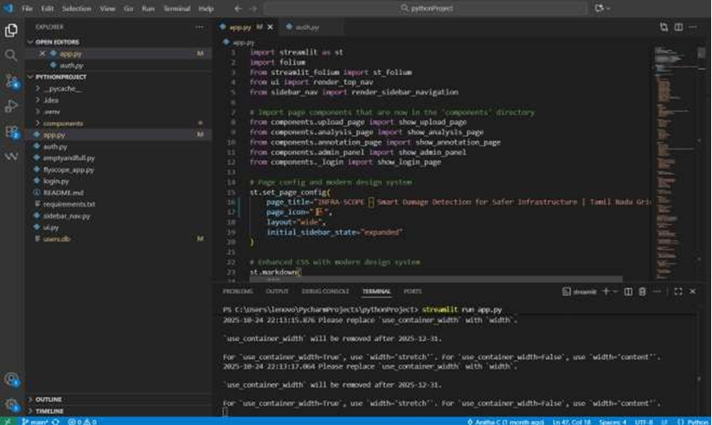
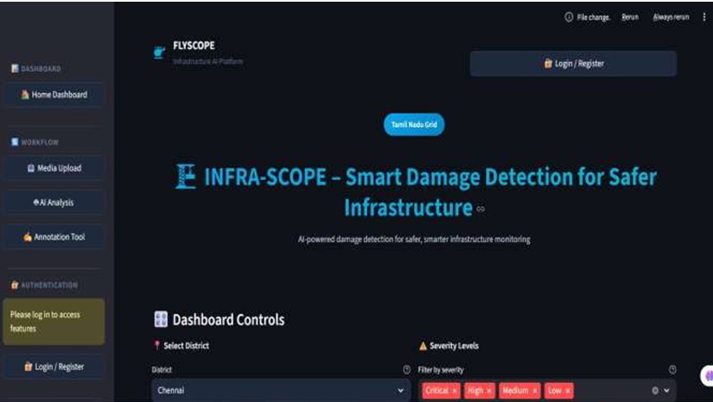
TESTING AND SCREENSHOTS

Slide 19
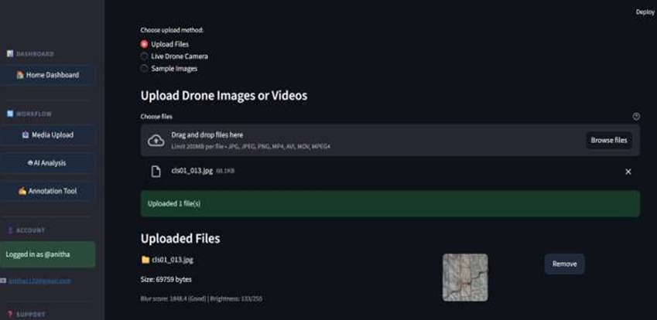
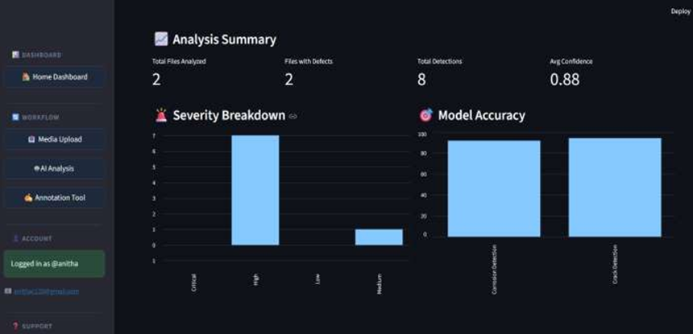
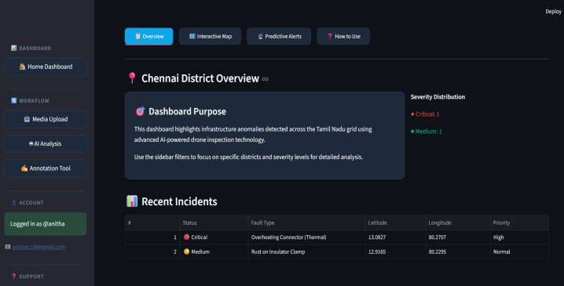
SCREENSHOTS

Slide 20
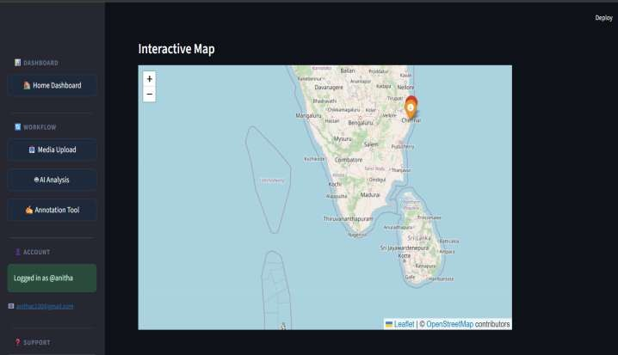
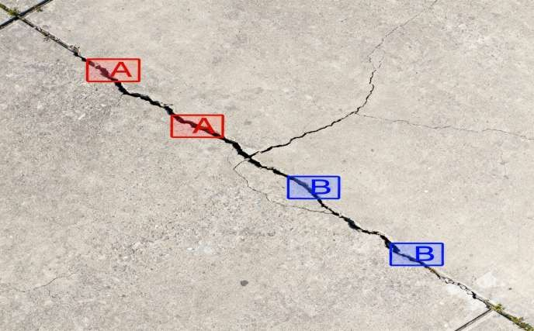
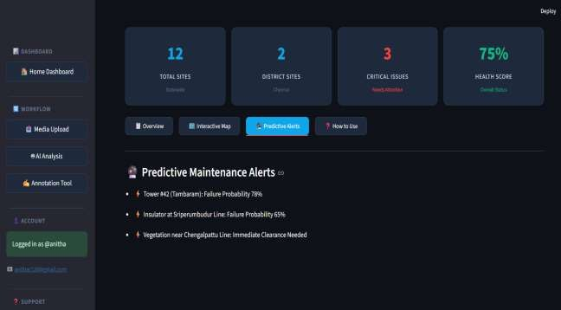
SCREENSHOTS

Slide 21
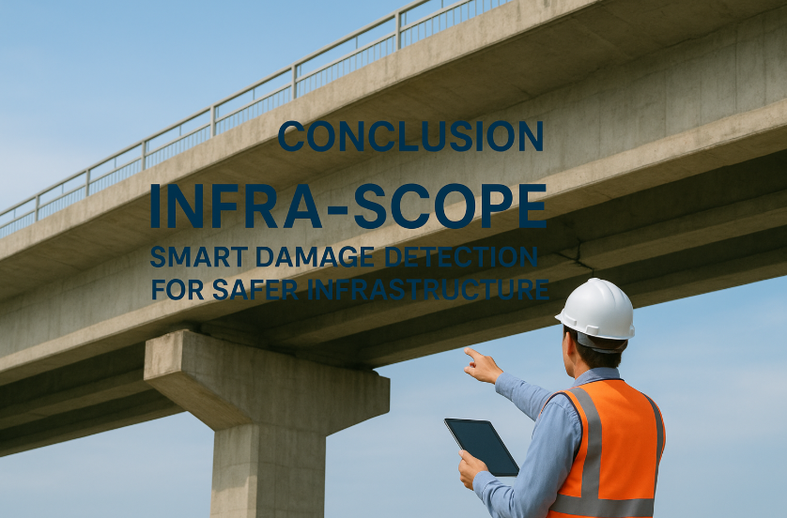
Conclusion
Automated Damage Detection: The proposed INFRA-SCOPE system effectively automates the process of infrastructure damage detection using advanced drone technology integrated with artificial intelligence for accurate and efficient inspections.
Enhanced Safety and Efficiency: By replacing risky manual inspections with drone-based operations, the system greatly improves safety, operational efficiency, and overall reliability of inspection activities.
Real-Time Data Insights: Real-time cloud connectivity enables instant data analysis and visualization, empowering authorities to take proactive maintenance decisions and prevent potential failures.
Cost and Time Optimization: The solution significantly reduces inspection costs, minimizes downtime, and enhances productivity, making large-scale infrastructure monitoring faster and more economical.
Sustainability and Resilience: By leveraging smart technology, INFRA-SCOPE promotes long-term sustainability, resilience, and smarter asset management for future-ready infrastructure systems.

Slide 22


Future works
Integration of LiDAR-Based 3D Mapping: Future versions of INFRA-SCOPE will integrate LiDAR technology to enable precise 3D spatial mapping and in-depth analysis of structural damages across complex infrastructures.
Swarm Drone Coordination: The system can be expanded to support swarm drone technology, allowing multiple drones to perform simultaneous inspections across large geographical areas, improving efficiency and coverage.
Advanced Transformer-Based AI Models: Incorporating transformer-based AI architectures will enhance the system’s ability to recognize multiple types of damages such as cracks, corrosion, and deformation with higher accuracy.
IoT-Enabled Continuous Monitoring: By connecting IoT sensors directly to the system, INFRA-SCOPE can achieve continuous real-time health tracking of infrastructures and send early alerts for preventive maintenance.
Offline Inspection Mode: Future enhancements will include offline operational capability, enabling drones to perform inspections and store data efficiently even in low or no connectivity environments.

Slide 23
Reference
1.EASA (2019) – EU-Wide Rules on Drones Published. Source: European Union Aviation Safety Agency.
2.eSmart Systems (2019) – Connected Drone Platform for Utilities. Source: eSmart Systems.
3.Scopito (2019) – Drone Data Management Platform. Source: Scopito.
4.Delair (2019) – Aerial Drone Solutions for Utilities. Source: Delair.
5.PwC (2017) – Clarity from Above: Leveraging Drone Technologies in Infrastructure. Source: PwC.
6.FlytBase (2020) – Automated Remote Inspection Software. Source: FlytBase.
7.Mehrooz G. et al. (2019) – Cloud Framework for Internet of Drones. Source: International Journal of Computer Applications.
8.Zhang J. et al. (2022) – High-Speed UAV Line Detection Model for Real-Time Power Line Monitoring. Source: IEEE Access.
9.Bowen O. et al. (2023) – Drone Framework for Power Line Monitoring. Source: IEEE Transactions on Industrial Electronics.
10.Kheterpal A., Gupta R., & Rao N. (2024) – AI-Driven Structural Health Monitoring System. Source: IEEE Sensors Journal.
11.Khaloo A., Lattanzi D., Jachimowicz A., & Devaney C. (2018) – Utilizing UAV and 3D Computer Vision for Visual Inspection of a Large Gravity Dam. Source: Frontiers in Built Environment. (Frontiers)
12.Akbar M. A., Qidwai U., & Jahanshahi M. R. (2019) – An Evaluation of Image-Based Structural Health Monitoring Using Integrated UAV Platform. Source: Structural Control & Health Monitoring. (QSpace)
13.Fayyad T. M., Taylor S., Feng K., & Hui F. K. P. (2024) – A Scientometric Analysis of Drone-Based Structural Health Monitoring and New Technologies. Source: Advances in Structural Engineering. (MDPI)
14.Stipanović I., Bracić M., Tica M., Skarić S., & Ganić E. (2024) – UAV Integration into Airport Infrastructure Inspection Procedures: Case Study Zagreb Airport. Source: University of Twente Research Information. (UT Research Information)
15.Tiwari A., Tejam A., Jolly L., & Vyas A. S. (2025) – Structural Health Monitoring Using Drone Technology. Source: International Journal for Research in Applied Science and Engineering Technology (IJRASET). (IJRASET)

Slide 24
Thank You

